Slide 1

Making this resource work for you
Prior to teaching this lesson, please refer to the ‘Unit Overview and Planning Document’.
Further guidance on planning Science Mastery lessons can be found in the detailed planning guidance document.
Refer to the ‘notes’ section on each slide for useful information, including suggested expositions, pedagogical content knowledge, suggested questions, answers and more. Consider using presenter mode so you can see this guidance throughout the lesson.
The introduction slides can be adapted to suit your teaching style and the needs of your class.
Before the lesson, adapt the fix-it slide to address any misconceptions identified in the previous lesson’s exit ticket.
Choose from the suggested activities to suit your class. The intention is not that you complete all of these, but that you select those which ones are most appropriate for your students. It may be appropriate to further adapt activities for your students.
These lessons are designed to occupy approximately 1 hour. To adapt for a shorter or longer lesson duration we advise you to adapt the activity section accordingly.
Please consider using the final slide to send feedback about this lesson or examples of PowerPoints that you have adapted to our design team. Your feedback is used to improve Science Mastery for all of our teachers and students. We appreciate all suggestions and comments.
Thank you for reading!
The Science Mastery Team

Slide 2
Prior Knowledge Review
Answer the questions below.
State the life processes.
Explain the difference between unicellular and multicellular organisms.
Explain what a microscope is used for.
State the organelles that are found in plant cells but not animal cells.
Name the organelle that is the site of aerobic respiration.
Movement, respiration, sensitivity, growth, reproduction, excretion and nutrition.
Unicellular organisms are made up of only one cell (e.g. bacteria), whereas multicellular organisms can be made up of any number of cells (e.g. plants and animals)
To magnify small objects that would otherwise not be visible with the naked eye.
Chloroplast, cell wall, vacuole
Mitochondria
Notes:
Foundation: List the organelles that can be found in a plant cell.
Stretch: Describe how a sperm cell is adapted for its function.
Answers:
Foundation: nucleus, cell membrane, cytoplasm, cell wall, vacuole, chloroplast, mitochondria, ribosomes
Stretch: It has a long tail to help it swim to the egg, many mitochondria to release energy and enzymes stored in the head to help break through the egg.

Slide 3


B3.1.1
24/05/2022
Prior Knowledge Review
B3.1.1 Prior Knowledge Review
B3.1.2 Eukaryotic and Prokaryotic Cells
B3.1.3 Aseptic Technique
B3.1.4 Growth of Bacteria
B3.1.5 Microscopes
B3.1.6 Observing Cells
B3.1.7 Diffusion
B3.1.8 Diffusion in Living Things
B3.1.9 Osmosis
B3.1.10 Osmosis Investigation
B3.1.11 Active Transport
B3.1.12 Cell Division
B3.1.13 Cancer
B3.1.14 Stem Cells
Notes:
This is the prior knowledge review lesson for this new unit. This unit requires a solid understanding of cell organelles and their functions and how to use a microscope, which will be practiced again. Pupils will also have to draw upon their knowledge of specialised cells from previous units, including sperm and egg cells, as well as the differences between sexual and asexual reproduction. Pupils will also be revisiting diffusion from Year 7 Chemistry but now in a different context so this lesson is an opportunity to ensure pupils are secure with the fundamentals of cells before moving on to more complicated ideas.
Big Idea: Cells are alive​
​
Suggested Hook:​
Our first biology topic for this year circles back to the idea that living things are all made up of cells. This topic we are going to look deeper into how cells work and will be introduced to some an advanced scientific instrument (electron microscope) that allows scientists to investigate cells in the highest amount of detail. We will look at transport of different biological molecules and how cells are arranged in order to ensure that large, multicellular organisms are able to obtain all of the different substances they need to stay alive and healthy. Then we will look at how the body works to replace damaged cells and what the implications can be if this process goes wrong. Finally, we will learn about some very exciting technology that can use cells to try and treat different types of previously untreatable diseases.
In order to fully understand everything we are planning on doing across the next few weeks, we first need to check that our cells knowledge from years 7 and 8 is up to scratch.

Slide 4

Following this lesson, students will be able to:
State the differences between plant and animal cells
Describe the features of plant and animal cells and the functions of each organelle
Describe how to view observe a slide under the microscope
Key Words:
nucleus
organelle
slide
specimen
cytoplasm
chloroplast

Slide 5
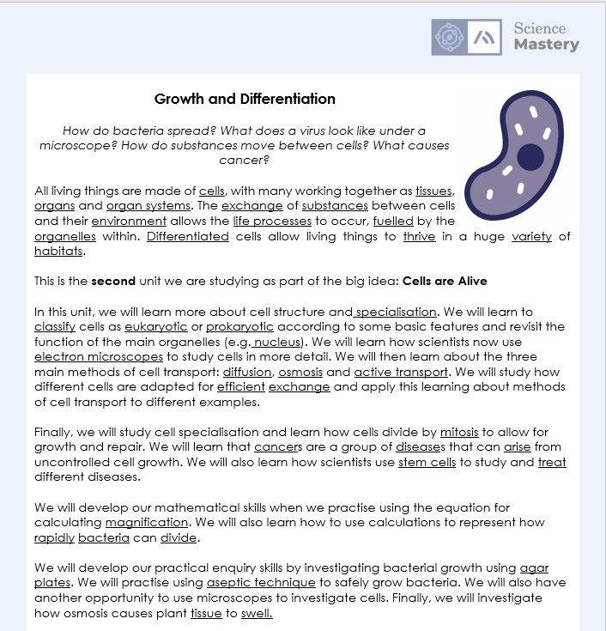
The Big Idea: Cells are Alive
Notes:
Purpose:. The purpose of this resource is to provide students with an overview at the beginning and end of each unit. It is designed to create a discussion about the unit prior to the sequence of lessons.
Teacher guidance:
Pupils should be directed to the B3.1 Link to Big Ideas worksheet (either in their booklet or printed).
Teachers should use guided reading techniques to read aloud with the pupils. Tier 3 vocabulary has been highlighted. (It may need to be adapted further for LPAs or pupils with different reading ages.)
Questions on the student sheet:
1. What are you most excited to learn about in this topic?
2. What do you already know about this topic?
3. Why do you think it’s important to learn that cells are alive?
4. What knowledge from previous science lessons might help us?
5. What questions do you have about this topic?
There are a range of ways to use this resource:
1. Display on a slide for students to read as a class. Direct students to complete the activities in their book.
2. Print off for students to stick into their book at the beginning of the unit along with their knowledge organiser. Complete as a guided reading task together. Direct students to complete the activities.
3. Have students complete as part of a booklet.
Set as a homework prior to a unit.
If you have any feedback about how this resource could be used/improved, please contact the science mastery team: sciencemastery@arkonline.org

Slide 6
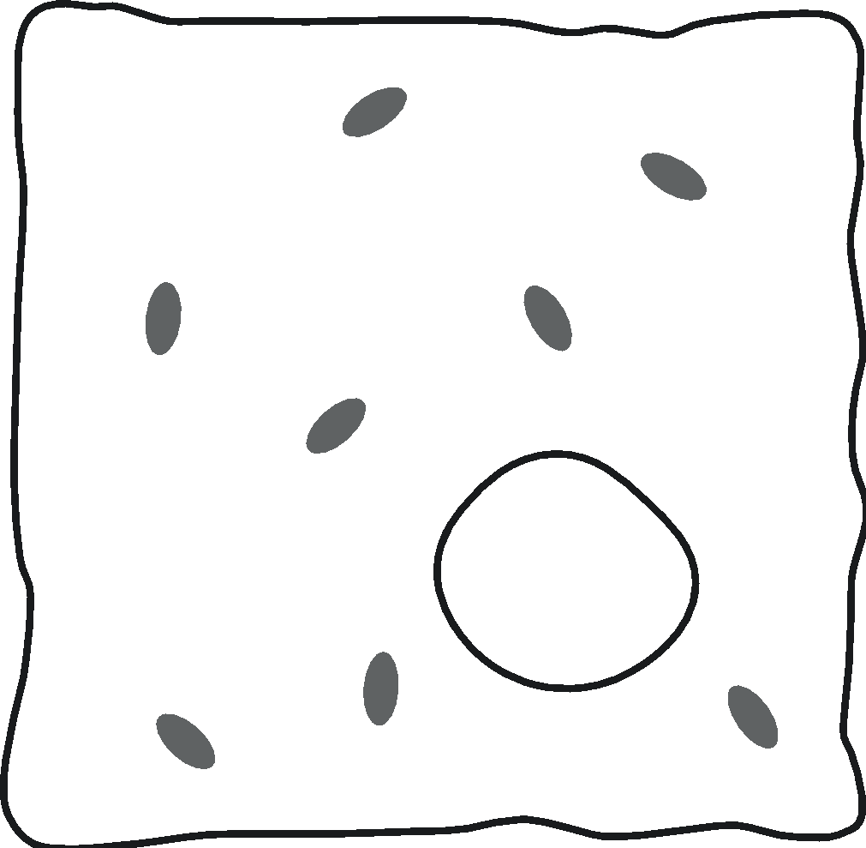
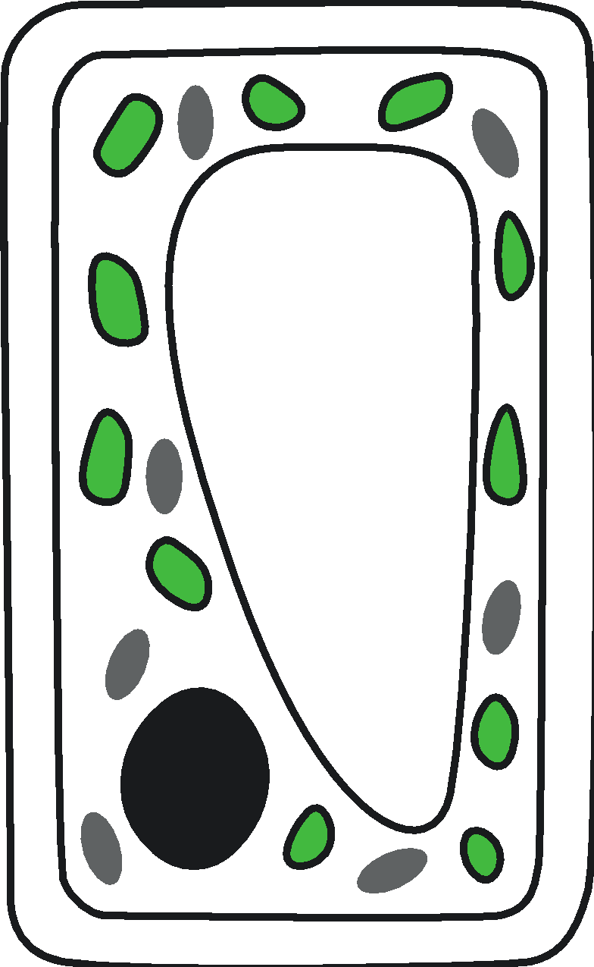
Plant and animal cells
Can you remember the parts of an animal and plant cell?
Plant and animal cells both contain a nucleus, cytoplasm, mitochondria and a cell membrane
Plant cells also contain a cell wall, chloroplasts and a vacuole
cell wall
mitochondria
cytoplasm
chloroplast
cell membrane
cell membrane
vacuole
nucleus
cytoplasm
nucleus
mitochondria
Notes:
Purpose: to spend time on any gaps from B1.1.
Pupils need to know the names and functions of each of the organelles and should be able to distinguish between organelles that are found in both animal and plant cells and those that are found in plant cells only.

Slide 7
Quick Quiz
State the function of each of the organelles
Nucleus
Cytoplasm
Cell membrane
Chloroplast
Vacuole
Cell wall
Controls the cell activities and contains the genetic material
Jelly-like substance where chemical reactions occur
Controls the substances that enter and leave the cell
Location of photosynthesis, contains chlorophyll to absorb sunlight
Contains liquid that stores substances for the cell and keeps it rigid
Surrounds plant cells and provides strength and support.
Notes:
Purpose: to check that key knowledge from the introduce phase has been learnt and understood. Encourage students to use the diagram to help them. This is very new learning for them at this stage.
Suggested guidance:
Either get pupils to write answers in books or give thinking time before cold calling. If pupils are still struggling with basic recall of the cell organelles it may be necessary to spend more time on review before moving on to the rest of the recap.

Slide 8
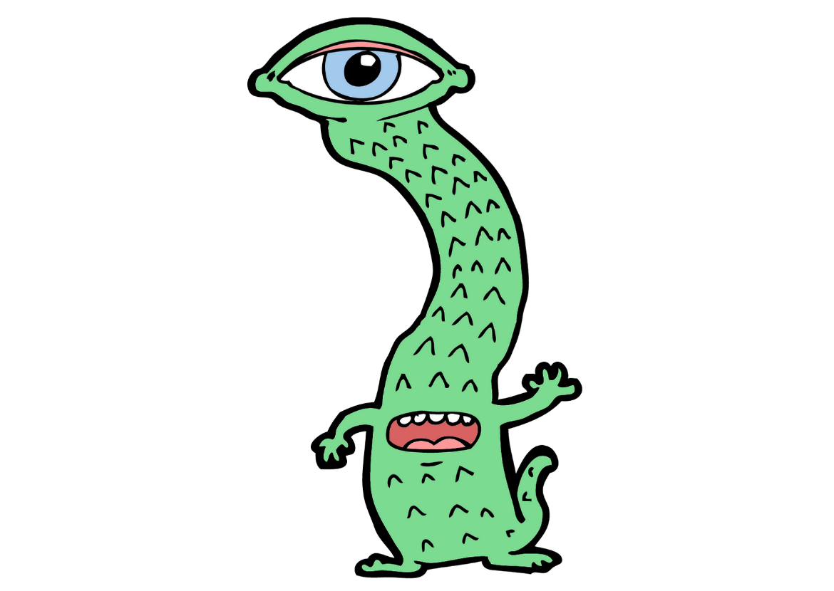
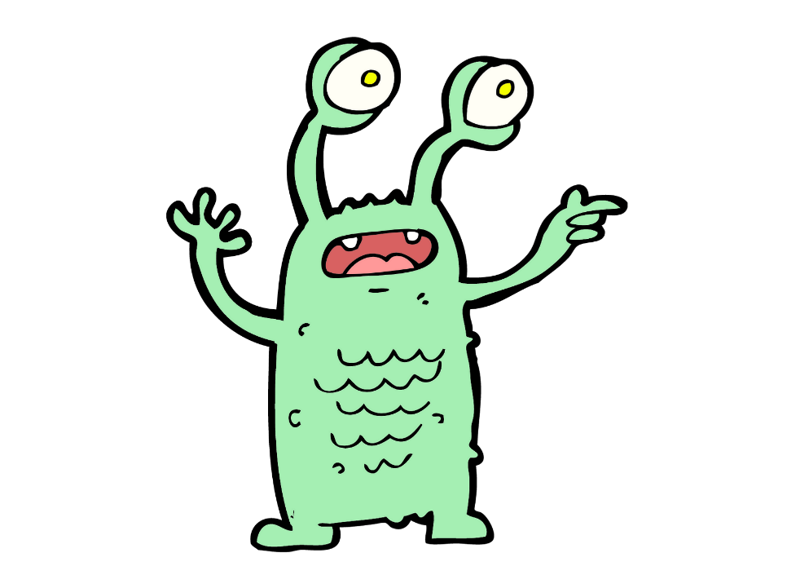
Out of this world!
How would you describe this word to an alien from space?
Microscope
Notes:
Ask students to discuss to gain an understanding of their prior knowledge and drawing out any issues with language around microscopes.
Possible questions you may want to use to get pupils to scaffold their answers:
what is the function of a microscope?
what is the difference between a microscope and a telescope?
what steps do you follow to view a slide under a microscope?
what are the different parts of the microscope and the function of each?
Based on feedback, you may need to re-teach the parts of the microscope (can do this physically with a microscope to aid retention) and may need to go over how to prepare a slide.
Suggested guidance:
Talk tasks can be used in a variety of ways to suit the particular needs of the students you are teaching. Through exchanging views with others, students develop their understanding of the science beyond what could be achieved individually.
Science classrooms that successfully integrate talk have the following features:
Science talk is a regular feature of lessons and is woven into classroom activities.
Students are paired or grouped strategically by the teacher to ensure productive interaction. This might take into consideration the students’ proficiency of the English language, how encouraging they might be to peers and their attainment in the topic. It’s a good idea to consider these pairings in the class seating plan.
Students are encouraged and supported to talk, but are not forced to talk.
The teacher should take on the role of a facilitator, engaging with conversations where necessary and encouraging or steering the conversation where needed.
Students are encouraged to use the language they have to express their ideas (e.g., everyday language, imperfect English, native language), but also to incorporate science specific terminology where this is more accurate or has been taught.
6. Scientifically inaccurate ideas are not dismissed by the partner or teacher; open discussion and further investigation are relied on to help students construct ideas that support them to progress in their scientific understanding.
7. Guidelines for behaviour during talk tasks are explicit and frequently reviewed. Rules for students might be:
Listen carefully to your partner
Take turns talking.
Speak one at a time, without interrupting.
Politely agree or disagree and explain why.
Politely point out if your partner has used a scientific word incorrectly, if they have explained the science incorrectly, or if there is a more accurate way to describe something.
If confused, ask questions.
Stay focused on the discussion topic.
Respond to one another.

Slide 9
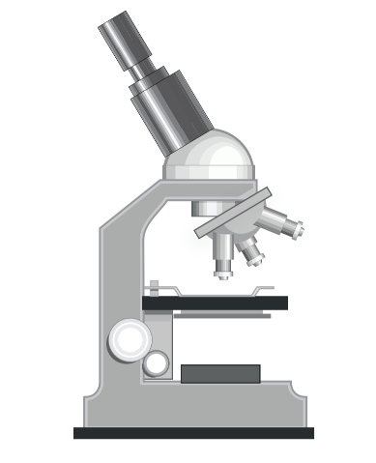
Cells and Microscope Review
Complete the worksheet by:
Describing an appropriate method to examine a cell under a light microscope
Identifying the structures and functions of specialised cells
Notes:
Purpose: students review prior learning from B1.1. Mark schemes provided for students to self or peer assess work.

Slide 10
Answer the questions below.
Which organelles do plant cells have but animal cells do not?
A. Nucleus, cell membrane, cytoplasm
B. Cell wall, vacuole, chloroplasts
C. Chloroplasts, cell membrane, nucleus
2. Which is the best explanation of the function of a microscope?
A. To make small objects easier to view
B. To see objects that are very far away
C. To make big objects seem smaller
3. Which statement has the cell organelle correctly matched with its function?
A. Cell wall, controls what enters and leaves the cell
B. Chloroplast, absorbs sunlight for respiration
C. Nucleus, controls cell activities and contains genetic information
✓
✓
✓
Notes:
Purpose: to find out if students are able to answer key questions that check for understanding of the residual knowledge in this lesson. This will inform where you start you next lesson from.
Suggested guidance for fix-it next lesson:
Q1. Answer: B
If pupils got Q1 wrong they have misconceptions around animal v plant cells. To fix it practice drawing animal and plant cells, with labels and functions of each organelle. Model drawing a plant and an animal cell and asked to identify which one is which and why- citing the extra organelles in plant cells as reasons. Alternatively use resources from B1.1 Cells unit.
Q2. Answer: A
If pupils got Q2 wrong their misconception is around why microscopes are used. If the answered B they could have confused with a telescope. To fix it, it could be useful to go through ‘The Scale of the Universe’ https://htwins.net/scale2/ to help pupils understand very small and very large objects. B suggests pupils are thinking of a telescope.
Q3. Answer: C
If pupils got Q3 wrong they have misconceptions around the functions of organelles. To fix it pupils need to practice questions on the functions of organelles. A match up task of organelles and functions would be an appropriate task or again use resources from unit B1.1.

Slide 11
Lesson B3.1.1
What was good about this lesson? | What can we do to improve this lesson?
Send us your feedback by clicking this link. Thank you!

